Slide 1
Machine Learning in Allocating and Building our Stock Portfolio

Slide 2
Hello!
I am Aprian Immanuel
I am here because I want to share how to be a Data Driven Investor.
You can find me at @aprianimmanuel

Slide 3
Background
STOCK TRADING
Non-performing assets can cause immense losses. However, if we have ML for assesment of the assets, the system delves deeper and digs to find out all relevant information
This one area where price is influenced not just by demand-supply but also by political factors, climate, company results and unforeseen calamities.
ML keeps track of all and integrates them into a predictive capability to keep us ahead of the game
THE RIGHT DECISIONS
Making the right decisions and grabbing opportunities in the fast moving world of finance can make a difference to your bottom line
This is where machine learning and artificial intelligence make a tangential difference
Market and Markets study shows that artificial intelligence in financial segment will grow to over $ 7.3 billion in 2022
Likewise, investments in other areas like bonds, mutual funds and real estate need to based on smart analysis of present and future while factoring external influencers. Therefore, if we have machine learning based system it would keep track of developments and alert us in advance so that we can be prepared.

Slide 4
OUR GOAL
1
We know how to build our long term porfolio with fully concern in maintaining and calculating the risk using Machine Learning Model

Slide 5
Risk comes from not knowing what you are doing – Warren Buffet

Slide 6
Dividend Investing
With recurring dividend payments, we invest in for as long as the company can support them, regardless of whether the company’s stock price is up or down

Slide 7

Final Project Workflow
Acquiring Dataset (Download financial statement from all public company listed in IDX)
Manually copying into dataset formed in SQL and CSV
Querying SQL (Exploratory Data Analysis) – New dataframe acquired!
Model Building and Return based Evaluation (Hierarchical and KMeans Clustering)
Domain Knowledge and Literature Study

Slide 8

What to look for when investing in dividends
Dividend safety
When looking at where to invest or buy a share, we seek dividend safety, which is typically measured by the dividend payout ratio. If the stock dividend payout ratio is high, then that company is likely a safe choice for dividend investing
High Yields
A dividend yield is a calculation that determines how much money we will earn for every rupiah invested at the current price based on the current dividend rate. To calculate it, we divide our cash dividend by the share price.

Slide 9

Beware of Dividend Traps
Dividend Yield are on a par
We can look at the other companies in the same industry and compare their dividend yields to make sure they are on a par. High yield can sometimes indicate that a company is in financial trouble
High Dividend Growth Rate
Investors buy stock in companies that currently paying lower than average dividend, but are growing extremely quickly.
Industry Health
We can look at the industry’s history and the current climate around it; for example, many investors speculate that healthcare services will boom in the next two or three decades.

Slide 10

How to decide if dividend investing is a good idea
Dividend are generally considered a sign of good financial health.
Dividend investing is a great way to build wealth through compounding.
However dividends are not a guarantee and can subjet to certain company related and economy risk.
It is also difficult – if not impossible - to make any significant money from dividend if we don’t have significant money on hand to invest.

Slide 11

We must determine if investing is worth the risk in the stock market and if we are willing to wait to see a return on our investment

Slide 12
Analysis for Risk Management in Stock Market Investing
Fundamental Analysis
Stock Market Investing
Technical Analysis
Sentiment Analysis

Slide 13
Workflow
Fundamental Analysis
Technical Analysis
Evaluation and Conclusion
Acquiring Dataset. SQL Querying. Financial Statement Fact Finding.
Portfolio Selection K-Means Clustering and Allocation using Hierarchical Clustering, and its Varian
Conditional Drawdown at Risk Metrics, Expected Shortfall Risk Metrics, etc
1
2
3

Slide 14
Fundamental Analysis
Financial Statement Fact Finding | SQL Querying | Exploratory Data Analysis

Slide 15
Fundamental Analysis and Fact Finding
Finance
Mining
Consumer Goods Industry
Agriculture
Infrastructure, Utilities and Transportation
Basic Industry and Chemicals
We are looking for a public company which has big and dividend payment, High dividen payout ratio, Less debt, and has good liquidity ratio
Property, Real Estate and Building Construction
Trade, Service and Investment
Miscellaneous Industry
We used conditional selection with SQL Querying and acquiring new dataframe contained our new public company list.

Slide 16
1st Dataset Feature
CompanyName | CodeName | Subsector | MRQuarter | FinYrEnd | IssShare | StInd | Sales | Assets | Liability | Equity | CashFlow | OpProfit | NetProfit | DPS | EPS | RPS | BVPS | CFPS | NAVS | DivYield | PER | PSR | PBVR | PCFR | DPR | GPM | OPM | NPM | EBITM | ROE | ROA | DER | CR | QR | CRR

Slide 17
Technical Analysis
Portfolio Selection and Allocation | Model Building (Clustering) | Return Based Evaluation

Slide 18
Technical Analysis Workflow
Importing Historical stock prices data from 2015 – 2020 from Yahoo Finance
Plotting the volatility of the stock price. The more increase of volatility, the investment is of greater risk
Build Portfolio using several portfolio strategy
Evaluation
Domain Knowledge and Literature Study

Slide 19
Portfolio Selection using Clustering

Slide 20
Why we need and use Clustering?
We want to make sense of and extract value from our dataset, in this case, financial statement and stock price dataset, to build our own better strategy in our investment.
However, we had no clue what to do in this case. This because we didn’t know yet the structure of the data. They are also a collection of unlabelled data.

Slide 21
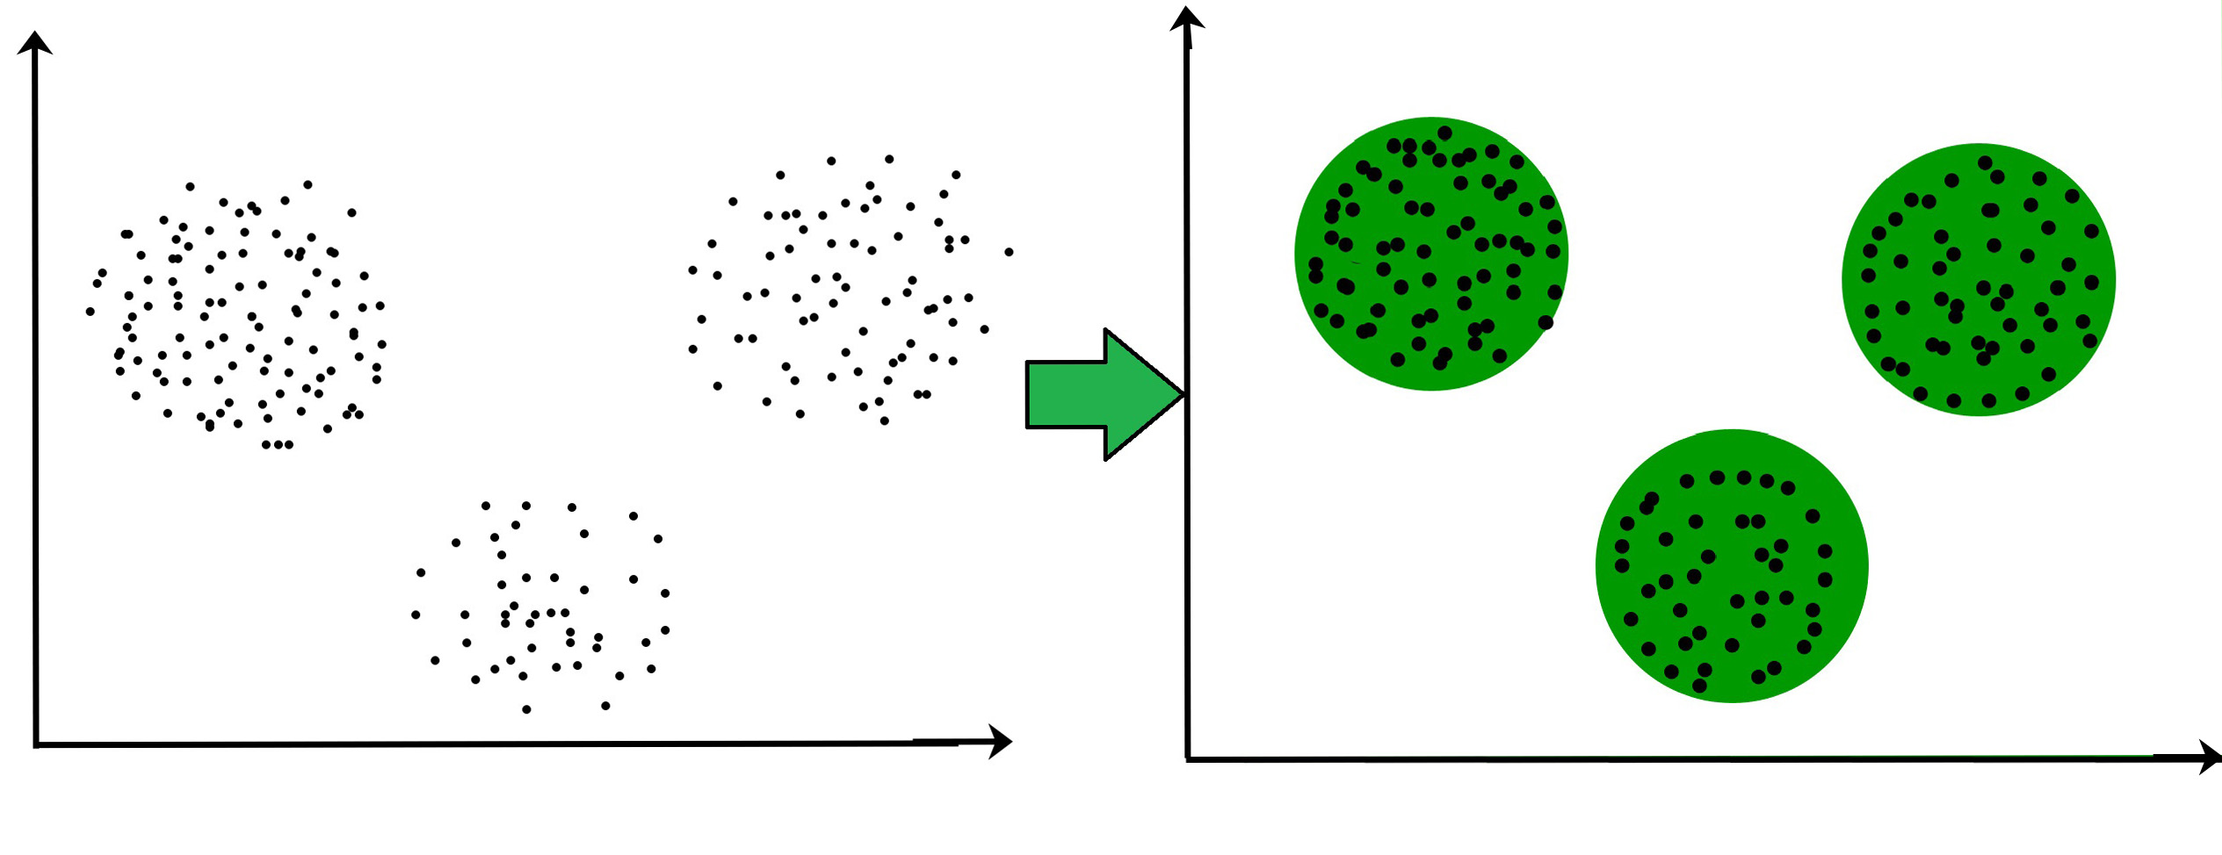
WHAT IS CLUSTERING?
Dividing the unlabelled population or data points into a number of groups which has more similarity to other data points..

Slide 22
Possible Applications
Marketing: Finding group of customers with similar behaviour given a large database of their properties and past buying records
Insurance: Identifying groups of motor insurance policy holders with a high average claim cost; identifying frauds.
Finance: Allocating weight of asset in investment

Slide 23
Hierarchical Clustering and its Varian
Type of Clustering Algorithm
KMeans Clustering
Connectivity Models
Centroid Models
Distribution Models
Density Models
Expectation – Maximization
DBSCAN and OPTICS

Slide 24
Portfolio Optimisation
Modern Portfolio Theory
Classical Markowitz Mean Variance Optimization
Black Litterman Models
Henry Markowitz - 1952
CRITICAL LINE ALGORITHM (CLA)
Portfolios are selected as follows;
From the portfolio that have the same return, the investor will prefer lower risk
From the portfolios that have the same risk level, an investor will prefer the portfolio with the higher rate of return

Slide 25
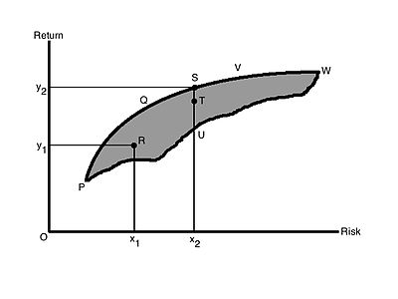
Mean Variance Model
X = Mean Expected Return
Y = Standard Deviation (variance) of the various portfolio

Slide 26
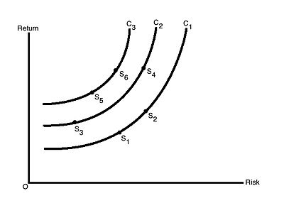


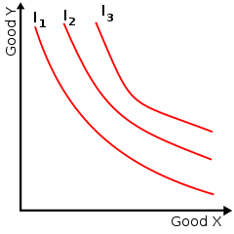
Risk Return Indifference Curve
Indifference curve connects points on a graph representing different quantities of two variables

Slide 27
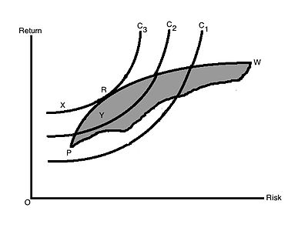
THE EFFICIENT PORTFOLIO

Slide 28
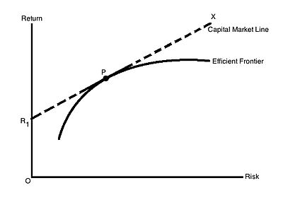
The Combination of Risk Free Securities with the Efficient Frontier and Capital Market Line

Slide 29
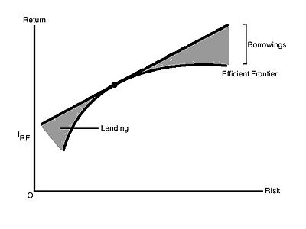
Capital Market Line and Risk Free Lending and Borrowing

Slide 30
To build our best portfolio, we need to;
Determine the efficient set
Choose the best portfolio using indifference curve and efficient frontier
Risk Free Rate return to build our lending portfolio
Borrow some funds at Risk Free Rate to buy more portfolio P

Slide 31
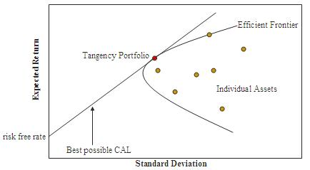
The efficient frontier or portfolio frontier is an investment portfolio which occupies the ‘efficient ‘ parts of the risk return spectrum.
Henry Markowitz developed a special algorithm called the Critical Line Algorithm (CLA) for developing the portfolio frontier. However, the algorithm comes with its own set of caveats
The CLA Algorithm can change significantly for small changes in market correlations
CLA is very depended on the estimation of stock-returns which is very hard to estimate with sufficient accuracy. This makes it hard to quanitfy the results of this algorithm
CLA considers the correlations between the return of all the assets in a portfolio and this leads to very large correlation dependency connected graph.
CLA is unstable to the volatility of the stock market.

Slide 32
All the disadvantages of CLA make CLA is unsuitable for practical applications.
This is where Hierarchical Risk Parity (HRP) by Marcos Lopez de Prado comes and improve upon them.

Slide 33
The HRP algorithm is computed throughout 3 main steps:
1. Hierarchical Clustering - breaks down our assets into hierarchical clusters
2. Quasi-Diagonalization - reorganizes the covariance matrix, placing similar assets together
3. Recursive Bisection - weights are assigned to each asset in our portfolio

Slide 34

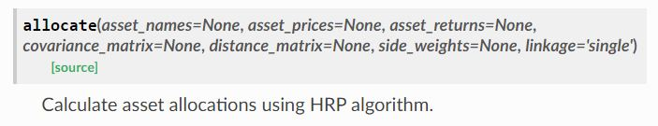
HRP Documentation

Slide 35
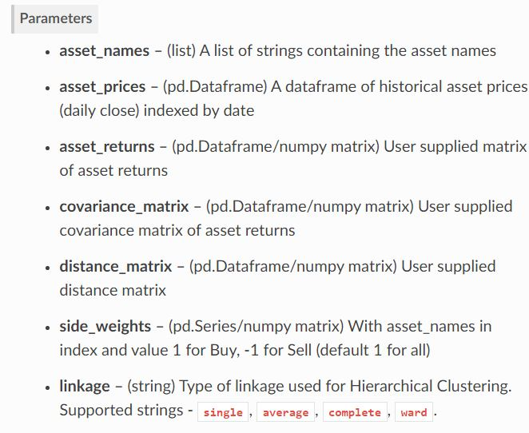
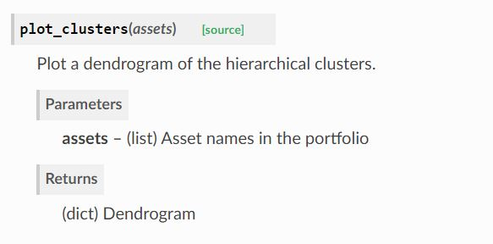
HRP Documentation

Slide 36
Does HRP have any disadvantage in building our best portfolio?
Hierarchical Risk Parity starts by reorganizing the covariance matrix to place similar investments together. Then it employs an inverse variance weighting allocation based on the number of assets with no further use of the clustering. HRP aims at diversifying risk allocation.
However, the chosen weighting scheme in HRP does not take risk into account, which can be problematic. Indeed, even if portfolios are diversified in terms of capital allocation, portfolios may be heavily concentrated in terms of risk allocation.
HRP also depends on the correlation between assets. From the theorical point of view, it seems more appropriate to make no assumptions on the correlation between clusters.

Slide 37
Yes, HRP algorithm have following drawbacks
HRP is based on the equivalence between Hierarchical Tree Clustering and the single linkage clustering algorithm. On the other hand, single linkage suffers from chaining. In order to merge two groups, only one pair of points need to be close, irrespective of all others. Therefore, clusters can be too spread out and not compact enough.
Hierarchical Tree Clustering is only used to reorder the assets. The shape of dendogram is not considered when the bisection is done. Only the number of assets matters.
The relevant number of clusters is not considered. Each asset is its own cluster. It may happen that we use more information then the clustering can provide with reliability. Intuitively, it can be seen as a form of overfitting, leading to potential bad results.
HRP used variance as the most common the risk metric. While variance is a good measure of risk, it is not good measure for the risk of assets with significant tail risk.

Slide 38
That’s why Thomas Raffinot in his paper
“ Hierarchical Clustering Based Asset Allocation” introduced Hierarchical Equal Risk Contribution (HERC) and improved Hierarchical Risk Parity (HRP)

Slide 39
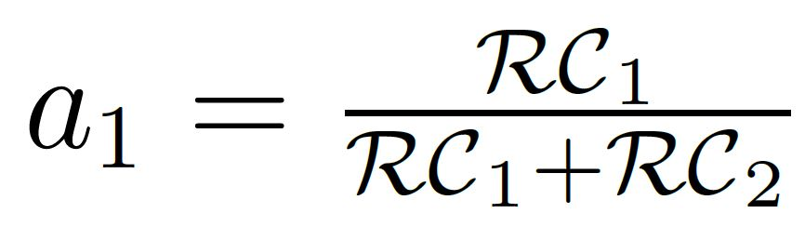
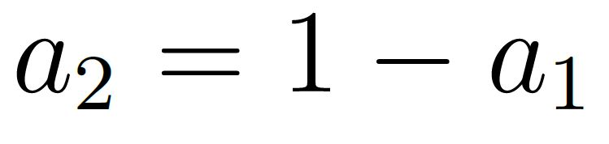
Hierarchical Equal Risk Contribution Portfolio (HERC)
HERC aims at diversifying capital allocation and risk allocation. It computes in four stages;
Hierarchical Clustering
Selection of the Optimal Number of Clusters based on the Gap Index
Top Down recursive division into two parts based on the dendogram and following an Equal Risk Contribution Allocation. The weights are
Where RC 1 is the Risk Contribution of the first cluster and RC2 is the risk contribution of the second cluster.
Naïve Risk Parity within clusters (with the same cluster the correlation between assets should be elevated

Slide 40
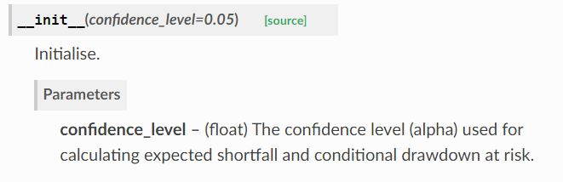
HERC Documentation

Slide 41
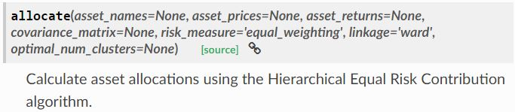
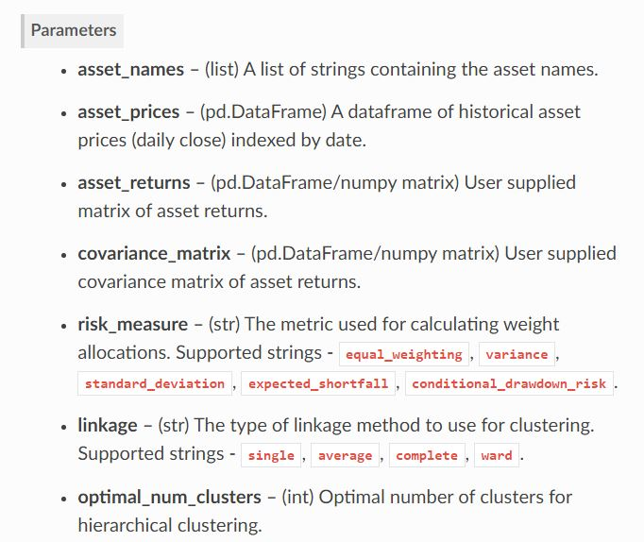
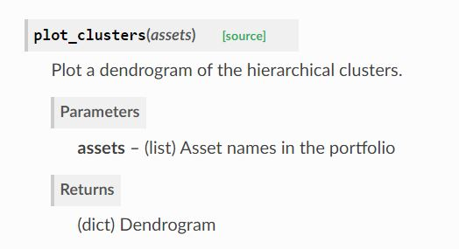
HERC Documentation

Slide 42
Exploratory Data Analysis
60 of 689 public companies (25 of 60 public companies with preferred financial statement method portfolio selection) with good financial health
Profiling Portoflio Allocation without K-Means Clustering
HRP
HREC
With K-Means Clustering
HRP
Inverse Variance
BCRP Strategy
HREC
Inverse Variance
CLA Algorithm
Workflow Review

Slide 43
Evaluation Metrics ^{[1] [2]}
Conditional Drawdown at Risk Metrics – The average of all drawdowns or cumulative losses in excess of a certain threshold
Expected Shortfall Risk Metrics – The expected return on the portolio in the worst q% of cases
Variance at Risk Metrics – The estimator how much a set of investments might lose (with a given probability), given a normal market conditions, in a set time period.
Sharpe Ratio – The average return earned in excess of the risk free rate per unit of volatiity or total risk
Probabilistic Sharpe Ratio - The probability that the estimated Sharpe Ratio exceeds a benchmark Sharpe Ratio
Information Ratio – The portfolio return beyond the returns of the a benchmark, usually an index, compared to the volatility of those returns
Minimum Record Length – The time period how long a track record should be in order to have statistical confidence that its Sharpe rato is above a given threshold
Bets Concentration - The uniformity of returns from bets. The closer the concentration is to 0, the more uniform the distribution of returns.

Slide 44
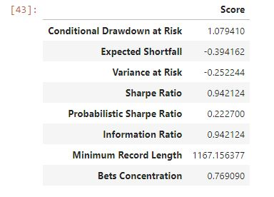
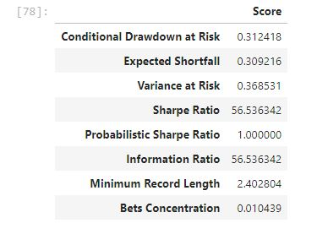
Without K-Means Clustering
With K-Means Clustering (Cluster 1)

Slide 45
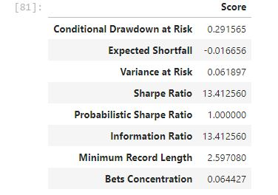
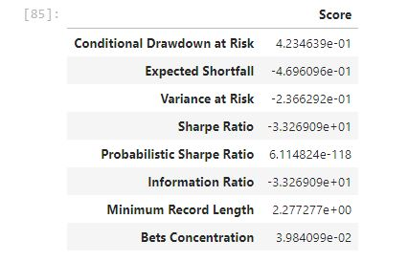
Portfolio Selection with K-Means Clustering (Allocation Algorithm with HERC, HRP, Inverse Variance and CLA Algorithm
Cluster 1
Cluster 2
Cluster 3

Slide 46
Conclusion
Every portfolio selection and allocation method has advantage and disadvantage sides. Investor needs to make assesment for their own risk profile.
Portfolio selection with K-Means Clustering has a better way solution in avoiding high risk yet with high return than without K-Means Clustering
Portfolio in Cluster 1 has better sharpe ratio but still has high variance at risk and conditional drawdown at risk compared to Cluster 2 and Cluster 3.
Cluster 3 has less risk than Cluster 1 and Cluster 2 but lower gain than Cluster 1 and Cluster 2.
Cluster 2 has more moderate risk metrics than Cluster 1 but higher gain than Cluster 3
Every portfolio selection and allocation method depends on stock price correlation, covariance matrix and financial stats for each company. That’s why investor needs to try different approach in finding a way to diversify and calculate risk – return based portfolio

Slide 47
Thanks!
Any questions?
You can find me at @aprianimmanuel or immanuelaprian@gmail.com

Slide 48
SlidesCarnival icons are editable shapes.
This means that you can:
Resize them without losing quality.
Change line color, width and style.
Isn’t that nice? :)
Examples:

Slide 49
Diagrams and infographics

Slide 50
😉
Now you can use any emoji as an icon!
And of course it resizes without losing quality and you can change the color.
How? Follow Google instructions https://twitter.com/googledocs/status/730087240156643328
✋👆👉👍👤👦👧👨👩👪💃🏃💑❤😂😉😋😒😭👶😸🐟🍒🍔💣📌📖🔨🎃🎈🎨🏈🏰🌏🔌🔑 and many more...

